Slide 1
CSE340 Computer Architecture

Slide 2
Chapter 2
Instructions: Language of the Computer
Supplementary Slides
Prepared by Fairoz Nower Khan Miss

Slide 3
Lecture 8
Instruction set and MIPS
MIPS assembly code
Register operands
Main memory
Memory operands
Slides prepared by Fairoz Nower Khan Miss

Slide 4
Computer Architecture (Microprocessor without Interlocked Pipelined Stages)
32 bit MIPS Architecture
Register File
Register 0 (32 bit)
Register 1 (32 bit)
Main Memory
Register 2 (32 bit)
ALU
Register 3 (32 bit)
Register 4 (32 bit)
.
.
.
.
Register 31 (32 bit)

Slide 5
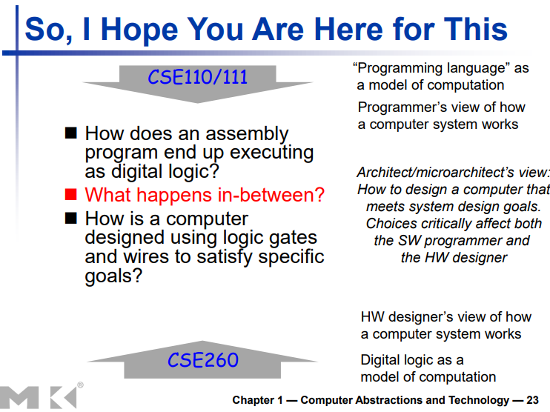

Slide 6
Instruction Set
§2.1 Introduction
The repertoire of instructions of a computer
Different computers have different instruction sets
But with many aspects in common
Early computers had very simple instruction sets
Simplified implementation
Many modern computers also have simple instruction sets

Slide 7
The MIPS Instruction Set
Used as the example throughout the book
Stanford MIPS commercialized by MIPS Technologies (www.mips.com)
Large share of embedded core market
Applications in consumer electronics, network/storage equipment, cameras, printers, …
Typical of many modern ISAs
See MIPS Reference Data tear-out card, and Appendixes B and E

Slide 8
Arithmetic Operations
Add and subtract, three operands
Two sources and one destination
add a, b, c # a gets b + c
All arithmetic operations have this form
Design Principle 1: Simplicity favours regularity
Regularity makes implementation simpler
Simplicity enables higher performance at lower cost
§2.2 Operations of the Computer Hardware

Slide 9
Arithmetic Example
C code:
f = (g + h) - (i + j);
Compiled MIPS code:
add t0, g, h # temp t0 = g + h add t1, i, j # temp t1 = i + j sub f, t0, t1 # f = t0 - t1

Slide 10
Register Operands
Arithmetic instructions use register operands
MIPS has a 32 × 32-bit register file
Use for frequently accessed data
Numbered 0 to 31
32-bit data called a “word”
Assembler names
$t0, $t1, …, $t9 for temporary values
$s0, $s1, …, $s7 for saved variables
Design Principle 2: Smaller is faster
c.f. main memory: millions of locations
§2.3 Operands of the Computer Hardware

Slide 11
Register Operand Example
C code:
f = (g + h) - (i + j);
f, …, j in $s0, …, $s4
Compiled MIPS code:
add $t0, $s1, $s2 add $t1, $s3, $s4 sub $s0, $t0, $t1

Slide 12
Register Operand Example
C code:
a = (c + d + e + f) – (r + x)
MIPS Code:
a is in -> $s0
c is in -> $s1
d is in -> $s2
e is in -> $s3
f is in -> $s4
r is in -> $s5
x is in -> $s6
add $t0, $s1, $s2
add $t1, $s3, $s4
add $t2, $t0, $t1
add $t3, $s5, $s6
sub $s0, $t2, $t3

Slide 13
Memory Operands
Main memory used for composite data
Arrays, structures, dynamic data
To apply arithmetic operations
Load values from memory into registers
Store result from register to memory
Memory is byte addressed
Each address identifies an 8-bit byte
Words are aligned in memory
Address must be a multiple of 4
MIPS is Big Endian
Most-significant byte at least address of a word
c.f. Little Endian: least-significant byte at least address

Slide 14
Main Memory
32 bit data
5 – 0000 0000 0000 0000 0000 0000 0000 0101
Each slot contains 8 bit data or 1 byte data
0
1
2
3
4
5
6
7
8
9
10
11
12
n
8 bit
0000 0000
8 bit
0000 0000
8 bit
0000 0000
0
4
8
12
16
2024
28
.
.
First Data
8 bit
0000 0101
Second Data
Next Data
Third Data
.
.
.
.
.
.
.
.
.
Next Data
To retrieve 32 bit data, how many slots we need to choose?
4
Next Data
.
.
.

Slide 15
Main Memory Operand Example 1
g is in -> $s1
h is in -> $s2
Base Address of A is in -> $s3
C code:
g = h + A[3]
0
4
8
12
16
2024
28
.
.
A[0]
A[1]
A[2]
.
.
.
.
.
.
.
.
A[3]
lw
$t0,
12($s3)
Base Address of A means -> where Array A starts
+
$s3
12
The Address of A[0]
Load word (32 bit)
-> lw
A[index] = 4*index(Base Address)

Slide 16
Main Memory Operand Example 1
g is in -> $s1
h is in -> $s2
Base Address of A is in -> $s3
C code:
g = h + A[3]
lw $t0, 12($s3)
add
$s1,
$s2,
$t0

Slide 17
Main Memory Operand Example 1
C code:
A[12] = h + A[8];
h in $s2, base address of A in $s3
48
lw
$t0,
32
($s3)
($s3)
add $t1, $s2, $t0
Store word (32 bit)
-> sw
sw
$t1,
48($s3)

Slide 18
Examples from the book slides…

Slide 19
Memory Operand Example 1
C code:
g = h + A[8];
g in $s1, h in $s2, base address of A in $s3
Compiled MIPS code:
Index 8 requires offset of 32
4 bytes per word
lw $t0, 32($s3) # load word add $s1, $s2, $t0
offset
base register

Slide 20
Memory Operand Example 2
C code:
A[12] = h + A[8];
h in $s2, base address of A in $s3
Compiled MIPS code:
Index 8 requires offset of 32
lw $t0, 32($s3) # load word add $t0, $s2, $t0 sw $t0, 48($s3) # store word

Slide 21
Lecture 9
Registers vs Memory
Immediate operands
Zero registers
Unsigned and signed integers
MIPS Register file review
MIPS Instructions
MIPS R-format Instructions
MIPS I-format Instructions
Slides prepared by Fairoz Nower Khan Miss

Slide 22
Registers vs. Memory
Registers are faster to access than memory
Operating on memory data requires loads and stores
More instructions to be executed
Compiler must use registers for variables as much as possible
Only spill to memory for less frequently used variables
Register optimization is important!

Slide 23
Immediate Operands
Constant data specified in an instruction
addi $s3, $s3, 4
No subtract immediate instruction
Just use a negative constant
addi $s2, $s1, -1
Design Principle 3: Make the common case fast
Small constants are common
Immediate operand avoids a load instruction

Slide 24
Immediate Operands
In case of subtraction
subi does Not Exist
Let’s consider $s1 = 12
And we want to subtract 5 from $s1 and store in $s1
12+ (-5) = 7
$s1= 7
addi
$s1,
$s1,
-5
Compiler cannot add or subtract two integers
Everything will be stored as 32 bit binary number
addi $s1, 12, 5
Not Possible
addi $s1, 14, -7
addi Destination Register, Source 1 Register, Integer

Slide 25
The Constant Zero or Zero Register
MIPS register 0 ($zero) is the constant 0
Cannot be overwritten
Useful for common operations
E.g., move between registers
add $t2, $s1, $zero
Zero Register or $zero always contains 32 bit 0
The value of $zero always remains 0, cannot change it

Slide 26
Moving values between registers
Suppose we want to move a value from $s2 to $t3. How can we do it?
add
$t3,
$s2,
$zero
Value in $s2 + $zero = Value in $s2
$t3 = Value in $s2
Or if we do not want to use $zero, we can also do this:
addi $t3, $s2, 0

Slide 27
Unsigned Binary Integers
Given an n-bit number
§2.4 Signed and Unsigned Numbers
Range: 0 to +2^{n} – 1
Example
0000 0000 0000 0000 0000 0000 0000 1011₂ = 0 + … + 1×2³ + 0×2² +1×2¹ +1×2⁰ = 0 + … + 8 + 0 + 2 + 1 = 11₁₀
Using 32 bits
0 to +4,294,967,295
For an 8 bit number then, the range would be: 0 to +((2^8)-1) so
0 to 255

Slide 28
2s-Complement Signed Integers
Given an n-bit number
Range: –2^{n – 1} to +2^{n – 1} – 1
Example
1111 1111 1111 1111 1111 1111 1111 1100₂ = –1×2³¹ + 1×2³⁰ + … + 1×2² +0×2¹ +0×2⁰ = –2,147,483,648 + 2,147,483,644 = –4₁₀
Using 32 bits
–2,147,483,648 to +2,147,483,647
For an 8 bit signed number then, the range would be: -2^(8-1) to +((2^(8-1))-1) so
-128 to +127

Slide 29
2s-Complement Signed Integers
Range: –2^{n – 1} to +2^{n – 1} – 1
Bit 31 is sign bit
1 for negative numbers
0 for non-negative numbers
–(–2^{n – 1}) can’t be represented
Non-negative numbers have the same unsigned and 2s-complement representation
Some specific numbers
0: 0000 0000 … 0000
–1: 1111 1111 … 1111
Most-negative: 1000 0000 … 0000
Most-positive: 0111 1111 … 1111

Slide 30
2s-Complement Signed Integers
Range: –2^{n – 1} to +2^{n – 1} – 1
Why –(–2^{n – 1}) or 2^{n – 1} cannot be represented?
Suppose for 8 bit representation, n = 8
The highest number in 8 bit signed number=
01111111 = 127
Sign
bit
(2^{8 – 1}) = 128 = 010000000
Sign
bit
9 bit
Same goes for 32 bit representation as well

Slide 31
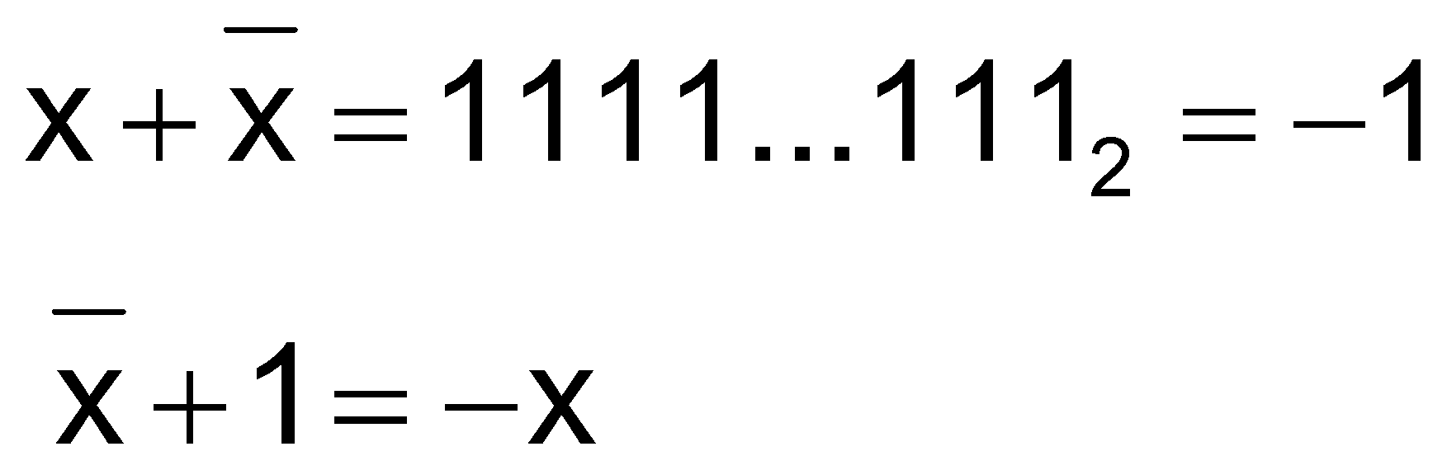
Signed Negation
Complement and add 1
Complement means 1 → 0, 0 → 1
Example: negate +2
+2 = 0000 0000 … 0010₂
–2 = 1111 1111 … 1101₂ + 1 = 1111 1111 … 1110₂

Slide 32
Sign Extension
Representing a number using more bits
Preserve the numeric value
In MIPS instruction set
addi: extend immediate value
lb, lh: extend loaded byte/halfword
beq, bne: extend the displacement
Replicate the sign bit to the left
c.f. unsigned values: extend with 0s
Examples: 8-bit to 16-bit
+2: 0000 0010 => 0000 0000 0000 0010
–2: 1111 1110 => 1111 1111 1111 1110

Slide 33
Representing Instructions
Register numbers
$t0 – $t7 are reg’s 8 – 15
$t8 – $t9 are reg’s 24 – 25
$s0 – $s7 are reg’s 16 – 23
-> $8 - $15
-> $24 - $25
-> $16 - $23
add $s0, $t0, $t1
Same instructions
add
$16,
$8,
$9

Slide 34
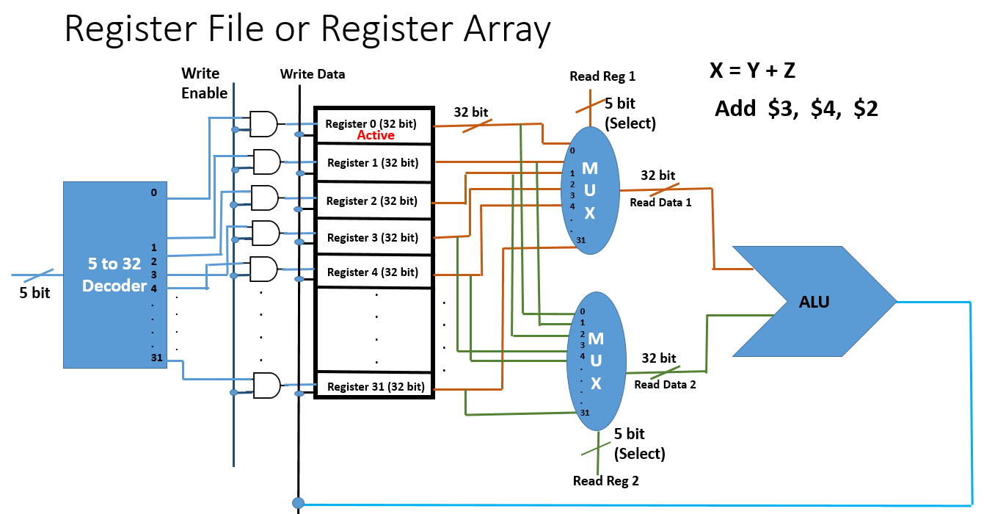

Slide 35
MIPS Register File
Register File
32 bits
5
32
src1 addr
src1
data
5
src2 addr
32
locations
5
dst addr
32
src2
data
Write
data
32
write control

Slide 36
MIPS Register File
Register File
32 bits
Holds thirty-two 32-bit registers
Two read ports and
One write port
5
32
src1 addr
src1
data
5
src2 addr
32
locations
5
Registers are
Faster than main memory
But register files with more locations are slower (e.g., a 64 word file could be as much as 50% slower than a 32 word file)
Read/write port increase impacts speed quadratically
Easier for a compiler to use
e.g., (A*B) – (C*D) – (E*F) can do multiplies in any order vs. stack
Can hold variables so that
code density improves (since register are named with fewer bits than a memory location)
dst addr
32
src2
data
32
write data
write control

Slide 37
Representing Instructions
Instructions are encoded in binary
Called machine code
MIPS instructions
Encoded as 32-bit instruction words
Small number of formats encoding operation code (opcode), register numbers, …
Regularity!
Register numbers
$t0 – $t7 are reg’s 8 – 15
$t8 – $t9 are reg’s 24 – 25
$s0 – $s7 are reg’s 16 – 23
§2.5 Representing Instructions in the Computer

Slide 38
MIPS Instructions
There are Three Types of MIPS Instructions
R Type
🡪 add, sub, and, or, sll, srl (shift) [Arithmatic operations]
I Type
🡪 lw, sw, addi, andi, ori, beq, bne
J Type
🡪 j (jump)

Slide 39
MIPS R-format Instructions
op
rs
rt
rd
shamt
funct
6 bits
5 bits
5 bits
5 bits
5 bits
6 bits
Instruction fields
op: operation code (opcode)
rs: first source register number
rt: second source register number
rd: destination register number
shamt: shift amount (00000 for now)
funct: function code (extends opcode)

Slide 40
R-format Example
Register numbers
$t0 – $t7 are reg’s 8 – 15
$t8 – $t9 are reg’s 24 – 25
$s0 – $s7 are reg’s 16 – 23
op
rs
rt
rd
shamt
funct
6 bits
5 bits
5 bits
5 bits
5 bits
6 bits
add $t0, $s1, $s2
add $8, $17, $18
special
$s1
$s2
$t0
0
add
0
17
18
8
0
32
000000
10001
10010
01000
00000
100000
00000010001100100100000000100000₂ = 02324020₁₆
0
2
3
2
4
0
2
0

Slide 41
Hexadecimal
Base 16
Compact representation of bit strings
4 bits per hex digit
0 | 0000 | 4 | 0100 | 8 | 1000 | c | 1100
1 | 0001 | 5 | 0101 | 9 | 1001 | d | 1101
2 | 0010 | 6 | 0110 | a | 1010 | e | 1110
3 | 0011 | 7 | 0111 | b | 1011 | f | 1111
Example: eca8 6420
1110 1100 1010 1000 0110 0100 0010 0000

Slide 42
Logical Operations
§2.6 Logical Operations
Instructions for bitwise manipulation
Operation | C | Java | MIPS
Shift left | << | << | sll
Shift right | >> | >>> | srl
Bitwise AND | & | & | and, andi
Bitwise OR | | | | | or, ori
Bitwise NOT | ~ | ~ | nor
Useful for extracting and inserting groups of bits in a word

Slide 43
Shifting
5
000101
001010
010100
Multiplication by 2^(the number of left shift)
5
10
20
Division by 2^(the number of Right shift)

Slide 44
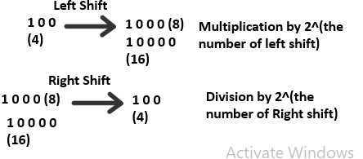
Shift Operations
op
rs
rt
rd
shamt
funct
6 bits
5 bits
5 bits
5 bits
5 bits
6 bits
shamt: how many positions to shift
Shift left logical
Shift left and fill with 0 bits
sll by i bits multiplies by 2^{i}
Shift right logical
Shift right and fill with 0 bits
srl by i bits divides by 2^{i} (unsigned only)
sll $t1, $s3, 2
srl $t2, $s3, 5

Slide 45
Shift Operations – R Type
op
rs
rt
rd
shamt
funct
6 bits
5 bits
5 bits
5 bits
5 bits
6 bits
sll $t1, $s3, 2
sll $9, $19, 2
000000
00000
$19
$9
2
sll
6 bits
5 bits
5 bits
5 bits
5 bits
6 bits
000000
00000
10010
01001
00010
xxxxxx
6 bits
5 bits
5 bits
5 bits
5 bits
6 bits

Slide 46
MIPS Code Practice
X = 2Y + 65Z - 10
Where X, Y and Z are in $s0, $s1 and $s2 respectively
add
$t0,
$s1,
$s1
$t0 🡪 2Y
sll
$t1,
$s2,
6
$t1 🡪 64Z
add
$t1,
$t1,
$s2
$t1 🡪 65Z
add
$t1,
$t0,
$t1
$t1 🡪 2Y+ 65Z
addi
$s0,
$t1,
- 10

Slide 47
AND Operations
Useful to mask bits in a word
Select some bits, clear others to 0
and $t0, $t1, $t2
rd rs rt
$t2
0000 0000 0000 0000 0000 1101 1100 0000
$t1
0000 0000 0000 0000 0011 1100 0000 0000
$t0
0000 0000 0000 0000 0000 1100 0000 0000

Slide 48
OR Operations
Useful to include bits in a word
Set some bits to 1, leave others unchanged
or $t0, $t1, $t2
rd rs rt
$t2
0000 0000 0000 0000 0000 1101 1100 0000
$t1
0000 0000 0000 0000 0011 1100 0000 0000
$t0
0000 0000 0000 0000 0011 1101 1100 0000

Slide 49
NOT Operations
Useful to invert bits in a word
Change 0 to 1, and 1 to 0
MIPS has NOR 3-operand instruction
a NOR b == NOT ( a OR b )
nor $t0, $t1, $zero
nor $t0, $t1, $t2
Register 0: always read as zero
rd rs rt
$zero
0000 0000 0000 0000 0000 0000 0000 0000
$t1
0000 0000 0000 0000 0011 1100 0000 0000
$t1 or $zero
0000 0000 0000 0000 0011 1100 0000 0000
$t0
1111 1111 1111 1111 1100 0011 1111 1111

Slide 50
MIPS I-format Instructions
For the instructions which have constants or whole numbers
addi $s0, $s1, 2
lw $t0, 12 ($s0)
sw $t1, 24 ($s1)
andi $t0, $t1, 5
ori $t0, $t1, 5

Slide 51
MIPS I-format Instructions
addi $s0, $s1, 2
op
rs
rt
constant or address
andi $t0, $t1, 2
6 bits
5 bits
5 bits
16 bits
ori $s0, $s1, 2
Immediate arithmetic and load/store instructions
rt: destination or source register number
Constant: –2¹⁵ to +2¹⁵ – 1
Address: offset added to base address in rs
Design Principle 4: Good design demands good compromises
Different formats complicate decoding, but allow 32-bit instructions uniformly
Keep formats as similar as possible
lw $t0, 12 ($s0)
sw $t1, 24 ($s1)

Slide 52
MIPS I-format Instructions
For the instructions which have something to do with constants or integers
addi $s0, $s1, 2
lw $t0, 12 ($s0)
sw $t1, 24 ($s1)
opcode
Base address / Source
Destination/ Source
Offset / Constant (in binary)
6 bits
(opcode)
5 bits
(rs)
5 bits
(rt)
16 bits
(offset)

Slide 53
MIPS I-format Instructions
MIPS has two basic data transfer instructions for accessing memory
lw $t0, 4($s3) #load word from memory
sw $t0, 8($s3) #store word to memory
The data is loaded into (lw) or stored from (sw) a register in the register file – a 5 bit address
The memory address – a 32 bit address – is formed by adding the contents of the base address register to the offset value
A 16-bit field meaning access is limited to memory locations within a region of ±2¹³ or 8,192 words (±2¹⁵ or 32,768 bytes) of the address in the base register
Note that the offset can be positive or negative

Slide 54
MIPS I-format Instructions
Load/Store Instruction Format (I format):
lw $t0, 24($s2)
op rs rt 16 bit offset
For lw and sw 🡪 Base Address will always be in rs

Slide 55
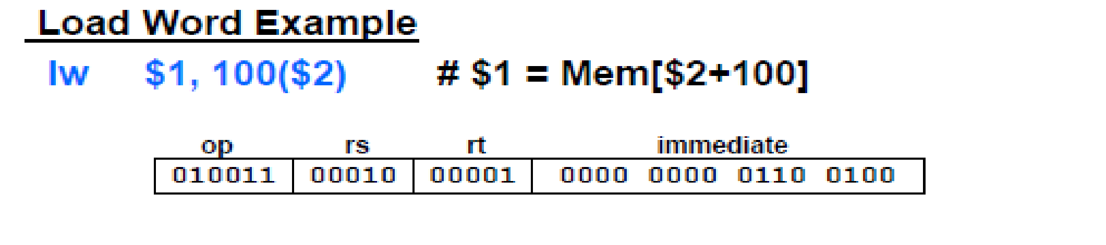
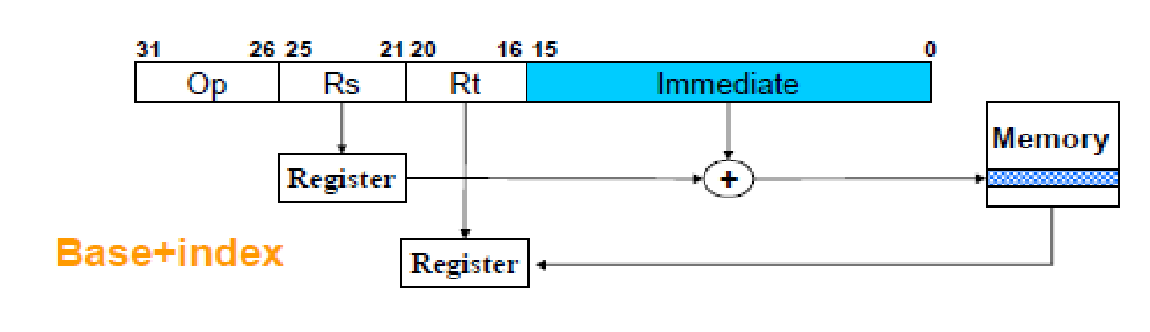
MIPS I-format Instructions
Load/Store Instruction Format (I format):
‹#›

Slide 56
MIPS I-format Instructions
Load/Store Instruction Format (I format):
lw $t0, 24($s2)
op rs rt 16 bit offset
Memory
24₁₀ + $s2 =
0xf f f f f f f f
. . . 0001 1000
+ . . . 1001 0100
. . . 1010 1100 =
0x120040ac
$t0
0x120040ac
$s2
0x12004094
0x0000000c
0x00000008
0x00000004
0x00000000
data
word address (hex)

Slide 57
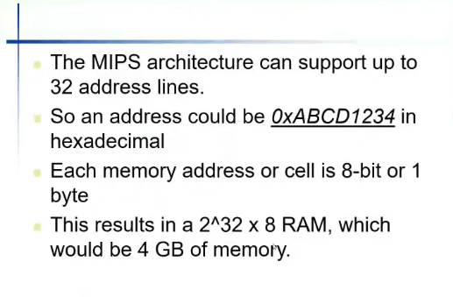

Slide 58
Lecture 10
Conditional operations
beq, bne
Program counter
Calculating branch destination addresses
Slides prepared by Fairoz Nower Khan Miss

Slide 59
MIPS I-format Instructions
For the instructions which have something to do with constants or integers
addi $7, $8, 2
lw $9, 12 ($10)
sw $17, 24 ($18)
op
rs
rt
constant or offset
beq $s0, $s1, L1
6 bits
5 bits
5 bits
16 bits
bne $8, $9, L1

Slide 60
Instruction Memory
0
4
8
12
16
2024
28
.
.
Instruction 1
Program Counter (PC)
Instruction 2
Instruction 3
Holds the address of current instruction
.
.
.
.
.
.
.
.
.

Slide 61
Conditional Operations
Branch to a labeled instruction if a condition is true
Otherwise, continue sequentially
beq rs, rt, L1
if (rs == rt) branch to instruction labeled L1;
bne rs, rt, L1
if (rs != rt) branch to instruction labeled L1;
j L1
unconditional jump to instruction labeled L1
§2.7 Instructions for Making Decisions
beq 🡪 branch is Equal
bne 🡪 branch is Not Equal

Slide 62
beq
Let’s consider the code:
if (a != b)
a = b + 1;
else
a = b + 2;
a
b
2
0
4
8
beq $s1, $s2, L1
if( rs = rt)
rs rt
add $s1, $s2, $t1
Go to L1
a
b
1
j Exit
$s1🡪 a
$s2🡪 b
$t1🡪 1
$t2🡪 2
12
L1:
add $s1, $s2, $t2
L1 gets converted into the number of instructions to jump over to where L1 is located
a
b
2
Exit:

Slide 63
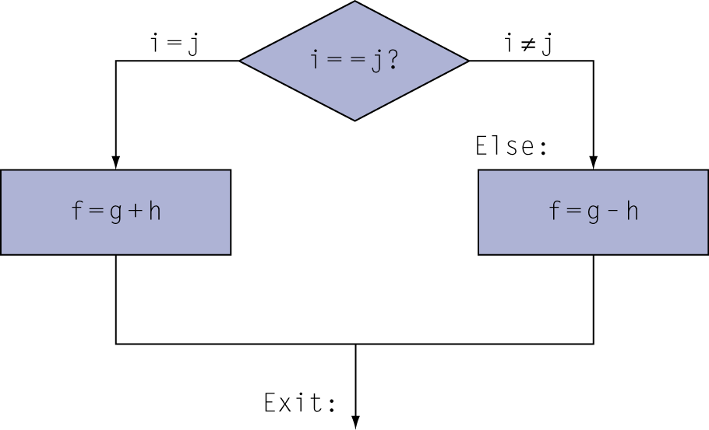
Compiling If Statements
C code:
if (i==j) f = g+h; else f = g-h;
f, g, … in $s0, $s1, …
Compiled MIPS code:
bne $s3, $s4, Else add $s0, $s1, $s2 j Exit Else: sub $s0, $s1, $s2 Exit: …
f🡪 $s0
g🡪 $s1
h🡪 $s2
i🡪 $s3
j🡪 $s4
Assembler calculates addresses

Slide 64
MIPS I-format Instructions
For the instructions which have constants or whole numbers
addi $7, $8, 2
lw $9, 12 ($10)
sw $17, 24 ($18)
op
rs
rt
constant or address
beq $s0,$s1, L1
6 bits
5 bits
5 bits
16 bits
bne $8, $9, L1
L1 gets converted into the number of instructions to jump over to where L1 is located

Slide 65
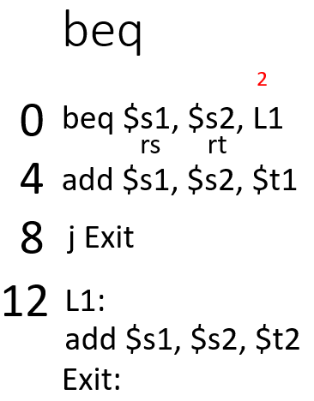
Program Counter
Program counter (instruction pointer) identifies the current instr.
Program counter is advanced sequentially except for control transfer instructions
PC (Program Counter) = 0

Slide 66
Compiling If Statements
C code:
if (i==j) f = g+h; else f = g-h;
f, g, … in $s0, $s1, …
Compiled MIPS code:
bne $s3, $s4, Else add $s0, $s1, $s2 j Exit Else: sub $s0, $s1, $s2 Exit: …
f🡪 $s0
g🡪 $s1
h🡪 $s2
i🡪 $s3
j🡪 $s4
Assembler calculates addresses

Slide 67
Specifying Branch Destinations
Use a register (like in lw and sw) added to the 16-bit offset
which register? Instruction Address Register (the PC)
its use is automatically implied by instruction
PC gets updated (PC+4) during the fetch cycle so that it holds the address of the next instruction
limits the branch distance to -2¹⁵ to +2¹⁵-1 instructions from the (instruction after the) branch instruction, but most branches are local anyway
from the low order 16 bits of the branch instruction
16
offset
sign-extend
00
branch dst
address
32
32
Add
PC
32
Add
32
4
32
?
32

Slide 68
Specifying Branch Destinations
from the low order 16 bits of the branch instruction
16
offset
sign-extend
00
2 bit left shift = offset x 4
branch dst
address
32
32
Add
PC
32
Add
32
4
32
?
32

Slide 69
J – Type Instruction
MIPS also has an unconditional branch instruction or jump instruction: j label #go to label
Instruction Format (J Format):
op 26-bit address

Slide 70
Specifying Branch Destination for Jump
op 26-bit address
from the low order 26 bits of the jump instruction
26
00
32
4
PC
32

Slide 71
MIPS Code Practice
B[10] = A[5] + 2
Where base address for B and A are $s1 and $s2 respectively
lw
$t0,
20($s2)
$t0 🡪 value of A[5]
addi
$t1,
$t0,
2
B 🡪 A[5] + 2
sw
$t1,
40($s1)

Slide 72
MIPS Code Practice
lw $t0,
12($s0)
$t0🡨 A[3]
lw $t1,
24($s0)
$t1🡨 A[6]
Base address of A is in $s0
beq $t0, $t1, Label1
bne $t0,
$zero, Label2
if (A[3] != A[6]){
addi $t7, $t0, 2
$t7🡨 $t0 + 2
if(A[3] == 0){
sw $t7, 12($s0)
A[3] = A[3] + 2; }
j Exit
else {
Label2:
A[6] = A[6] / 16; }
srl $t6, $t1, 4
$t6🡨 $t1 / 2^4
}
sw $t6, 24($s0)
j Exit
else {
Label1:
A[6] = A[6] * 8;
sll
$t5,
$t1,
3
$t5🡨 $t1 * 2^3
}
sw $t5,
24($s0)
Exit

Slide 73
More Conditional Operations slt, slti 🡪 R Type (slt), I Type (slti)
$s3 = 5
$s4 = 10
Set result to 1 if a condition is true
Otherwise, set to 0
slt rd, rs, rt
if (rs < rt) rd = 1; else rd = 0;
slti rt, rs, constant
if (rs < constant) rt = 1; else rt = 0;
Use in combination with beq, bne
slt $t0, $s1, $s2 # if ($s1 < $s2) bne $t0, $zero, L # branch to L
slt $t1, $s3, $s4
$t1 = 1
slti $t2, $s3, 2
$t2 = 0

Slide 74
Conditional Operations
a and b is in $s0 and $s1 respectively
a b
if (a>=b){
a= a+1;}
else{
a=a+2;
}
slt $t1, $s0, $s1
($s0>$s1), $t1 = 0
bne $t1, $zero, L1
addi $s0, $s0, 1
j Exit
L1:
addi $s0, $s0, 2
Exit

Slide 75
Branch Instruction Design
Why not blt, bge, etc?
Hardware for <, ≥, … slower than =, ≠
Combining with branch involves more work per instruction, requiring a slower clock
All instructions penalized!
beq and bne are the common case
This is a good design compromise

Slide 76
Signed vs. Unsigned
Signed comparison: slt, slti
Unsigned comparison: sltu, sltui
Example
$s0 = 1111 1111 1111 1111 1111 1111 1111 1111
$s1 = 0000 0000 0000 0000 0000 0000 0000 0001
slt $t0, $s0, $s1 # signed
–1 < +1 ⇒ $t0 = 1
sltu $t0, $s0, $s1 # unsigned
+4,294,967,295 > +1 ⇒ $t0 = 0

Slide 77
MIPS Code Practice
x = A[i] + 2
Where x, base address of A and i are in $s1, $s2 and $s3 respectively
sll
$t0,
$s3,
2
$t0 🡪 4*i
add
$t1,
$s2,
$t0
$t1 🡪 4*I + $s3
lw
$t2,
0($t1)
$t2 🡪 the value in A[i]
addi
$s1,
$t2,
2

Slide 78
Compiling Loop Statements
i= $s3
k= $s5
Base address of save= $s6
a= $s4
Java code:
while(save[i] == k){
a= a+2;
i+=1;
}
Compiled MIPS code:
Loop:
sll
$t0,
$s3,
2
add
$t1,
$s6,
$t0
lw
$t0,
0($t1)
bne
$t0,
$s5,
Exit
addi
$s4,
$s4,
2
addi
$s3,
$s3,
1
j
Loop
Exit:

Slide 79
Compiling Loop Statements
i -> $s3
k -> $s5
Base address of save🡪 $s6
a -> $s4
Java code:
for (int i=0; save[i]>k;i++){
a= a+2; }
Compiled MIPS code:
add
$s3,
$zero,
$zero
Loop:
sll
$t0,
$s3,
2
add
$t1,
$s6,
$t0
lw
$t0,
0($t1)
slt
$t5,
$t0,
$s5
bne
$t5,
$zero,
Exit
addi
$s4,
$s4,
2
addi
$s3,
$s3,
1
j
Loop
Exit:

Slide 80
Compiling Loop Statements
Compiled MIPS code:
Java code:
for (int i=0; i<15;i++){
if (A[i+1] !=0){
sum = sum +1;
else
sum = sum -1;
}
add
$s3,
$zero,
$zero
Loop:
slti
$t0,
$s3,
15
beq
$t0,
$zero,
Exit
addi
$t0,
$s3,
1
sll
$t0,
$t0,
2
add
$t1,
$s6,
$t0
lw
$t0,
0($t1)
beq
$t0,
$zero,
Else
addi
$s1,
$s1,
1
i is in $s3
Base address of A is in $s0
Sum is $s1
addi
$s3,
$s3,
1
j
Loop
Else:
addi
$s1,
$s1,
-1
addi
$s3,
$s3,
1
j
Loop
Exit:

Slide 81
MIPS Code Practice
A[B[i]] = x
Where base address for A and B are $s1 and $s2 respectively and x and i are in $s3 and $s4
sll
$t0,
$s4,
2
add
$t1,
$s2,
$t0
lw
$t2,
0($t1)
sll
$t0,
$t2,
2
add
$t1,
$s1,
$t2
sw
$s3,
0($t1)

Slide 82
2^n bit Architecture
32 bit Architecture – Each register is of 32 bit. Data memory and instruction memory with 8 bit slots. So memory increment by 4 (32/8)
64 bit architecture
128 bit Architecture
256 bit Architecture
0
4
8
12
16
2024
28
.
.
First Data
Second Data
Third Data
.
.
.
.
.
.
.
.
.

Slide 83
Address for 32 bit Architecture
Memory Address for a data in Array = Base Address + Index x 4
Branch Address = PC+ 4 + Offset x 4
Jump Address = PC (MSB 4 bits)+ Offset x 4

Slide 84
Procedure Calling
Steps required
Place parameters in registers
Transfer control to procedure
Acquire storage for procedure
Perform procedure’s operations
Place result in register for caller
Return to place of call
§2.8 Supporting Procedures in Computer Hardware

Slide 85
Register Usage
$a0 – $a3: arguments (reg’s 4 – 7)
$v0, $v1: result values (reg’s 2 and 3)
$t0 – $t9: temporaries
Can be overwritten by callee
$s0 – $s7: saved
Must be saved/restored by callee
$gp: global pointer for static data (reg 28)
$sp: stack pointer (reg 29)
$fp: frame pointer (reg 30)
$ra: return address (reg 31)
#Function Parameters Registers
#Function Result Registers
#Return address of main function

Slide 86
32-bit Constants
op
rs
rt
constant or address
6 bits
5 bits
5 bits
16 bits
Most constants are small
16-bit immediate is sufficient
For the occasional 32-bit constant
lui rt, constant
Copies 16-bit constant to left 16 bits of rt
Clears right 16 bits of rt to 0
addi $s0, $s1, 2
8194304
0000 0000 0111 1101 0000 1001 0000 0000
lui $s0, 125
0000 0000 0111 1101 0000 0000 0000 0000
ori $s0, $s0, 2304
0000 0000 0111 1101 0000 1001 0000 0000

Slide 87
Branch Addressing
bne/ beq instructions
Branch instructions specify
Opcode, two registers, target address
Most branch targets are near branch
Forward or backward
beq $a, $b, L1
bne $8, $9, L1
op
rs
rt
constant or address
6 bits
5 bits
5 bits
16 bits
PC-relative addressing
Target address = (PC+4) + offset × 4
PC already incremented by 4 by this time

Slide 88
Specifying Branch Destinations
from the low order 16 bits of the branch instruction
16
offset
sign-extend
00
2 bit left shift = offset x 4
branch dst
address
32
32
Add
PC
32
Add
32
4
32
?
32

Slide 89
Jump Addressing
Jump (j and jal) targets could be anywhere in text segment
Encode full address in instruction
op
address
6 bits
26 bits
(Pseudo)Direct jump addressing
Target address = PC_{31…28} : (address × 4)

Slide 90
Specifying Branch Destination for Jump
op 26-bit address
from the low order 26 bits of the jump instruction
26
00
32
4
PC
32

Slide 91
Target Addressing Example
Loop code from earlier example
Assume Loop at location 80000
Loop: sll $t1, $s3, 2 | 80000 | 0 | 0 | 19 | 9 | 2 | 0
add $t1, $t1, $s6 | 80004 | 0 | 9 | 22 | 9 | 0 | 32
lw $t0, 0($t1) | 80008 | 35 | 9 | 8 | 0
bne $t0, $s5, Exit | 80012 | 5 | 8 | 21 | 2
addi $s3, $s3, 1 | 80016 | 8 | 19 | 19 | 1
j Loop | 80020 | 2 | 20000
Exit: … | 80024

Slide 92
Branching Far Away
If branch target is too far to encode with 16-bit offset, assembler rewrites the code
Example
beq $s0,$s1, L1
↓
bne $s0,$s1, L2 j L1 L2: …
op
rs
rt
constant or address
6 bits
5 bits
5 bits
16 bits
op
address
6 bits
26 bits
If L1 is more than 16 bits,
The assembler rewrites the code to allocate 26 bits for L1 by using j type instruction
Notes:
If s0

Slide 93
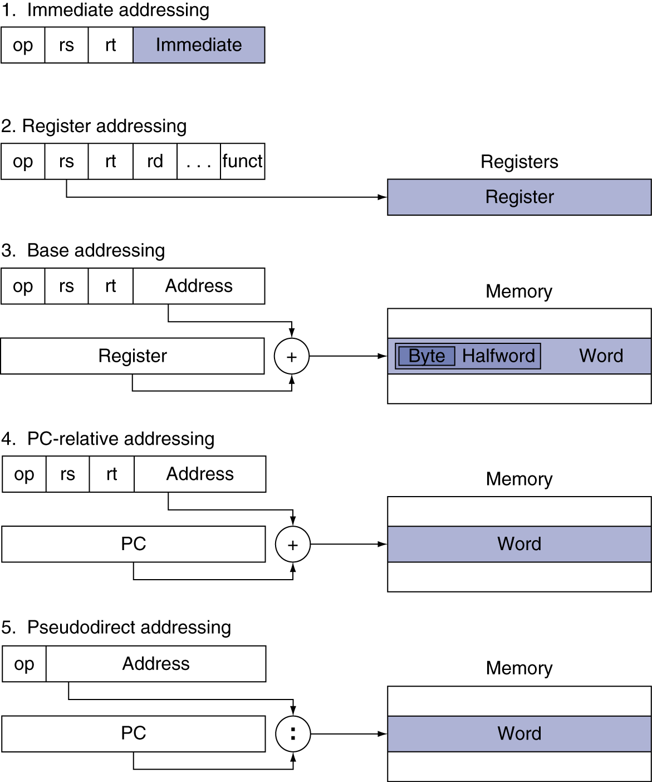

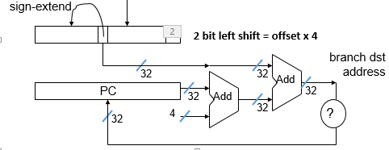
Addressing Mode Summary
addi $9, $10, 4
xxxxx
$10
$9
4
6 bits
5 bits
5 bits
16 bits
0
$10
$11
$9
0
add
add $9, $10, $11
R Type
6 bits
5 bits
5 bits
5 bits
5 bits
6 bits
xxxxx
$s0
$t0
40
lw $t0, 40($s0)
Load/ Store
5 bits
5 bits
16 bits
beq $t0, $t1, L1
xxxxx
$t0
$t1
L1
Beq/ Bne
j 1024
J type

Slide 94
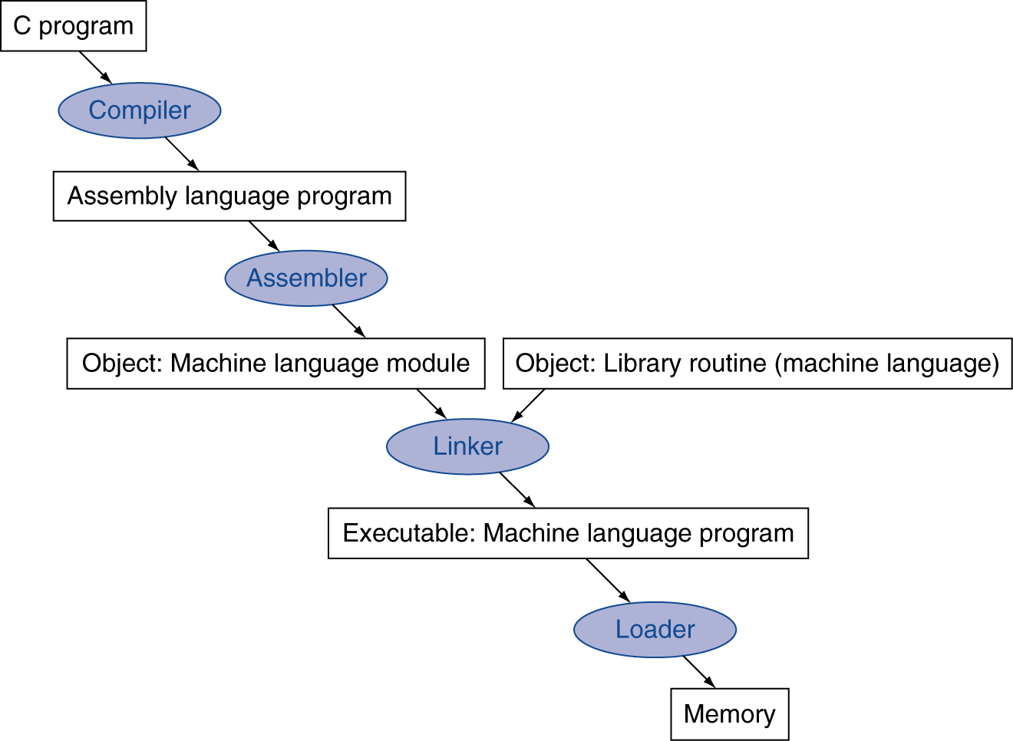
Translation and Startup
Many compilers produce object modules directly
§2.12 Translating and Starting a Program
Static linking

Slide 95
Assembler Pseudoinstructions
Most assembler instructions represent machine instructions one-to-one
Pseudoinstructions: figments of the assembler’s imagination
move $t0, $t1 → add $t0, $zero, $t1
blt $t0, $t1, L → slt $at, $t0, $t1 bne $at, $zero, L
$at (register 1): assembler temporary

